Slide 1
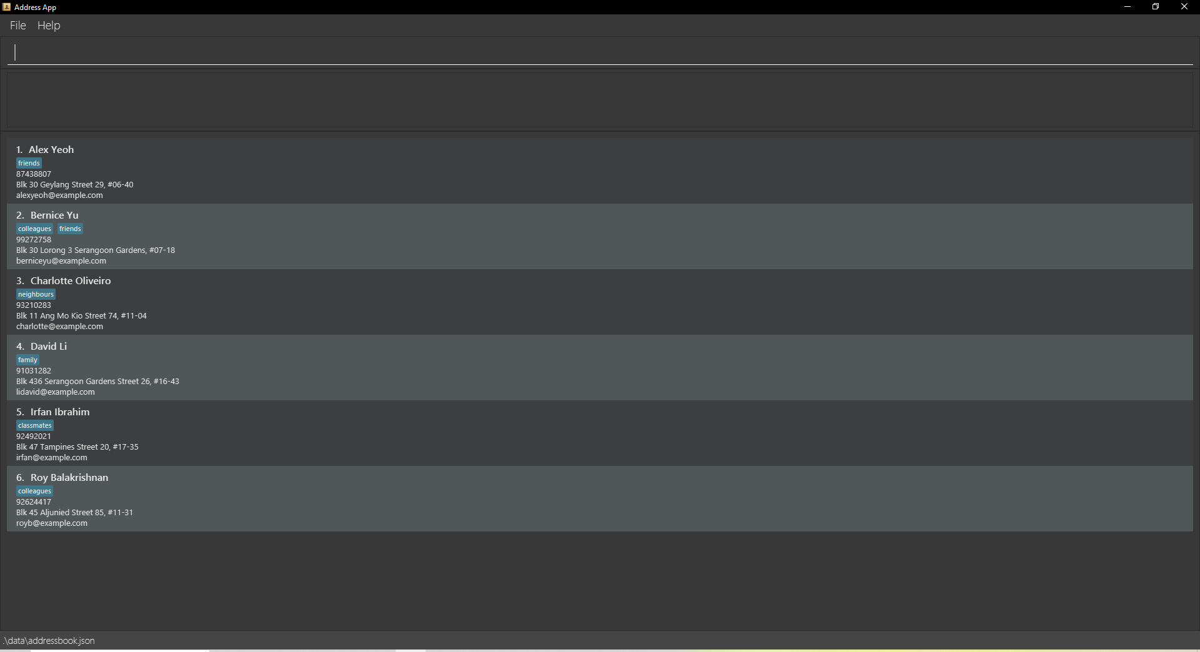
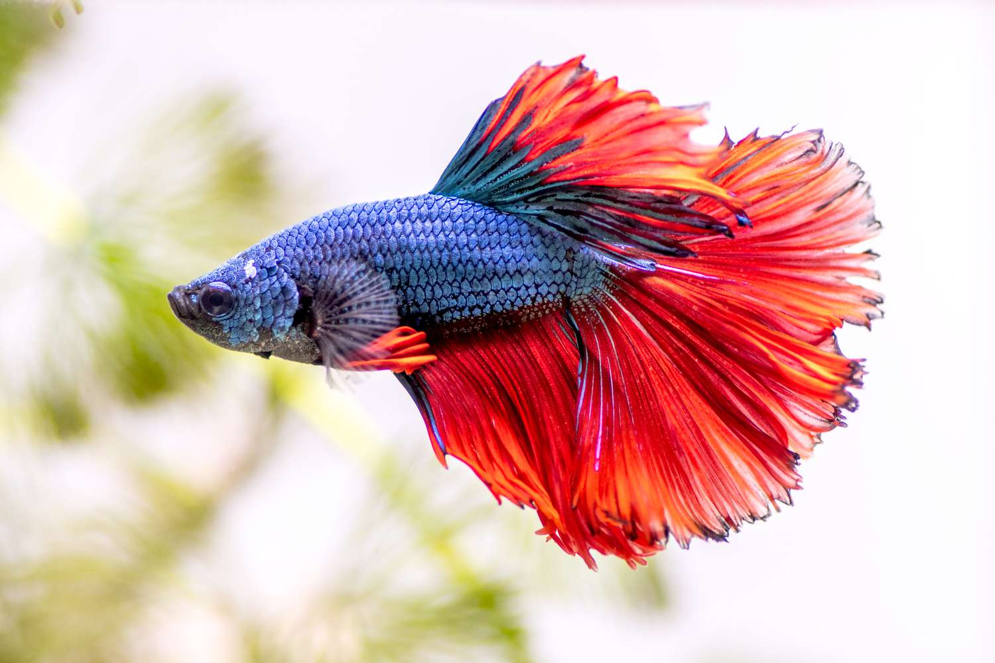

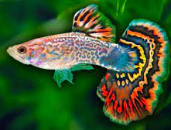
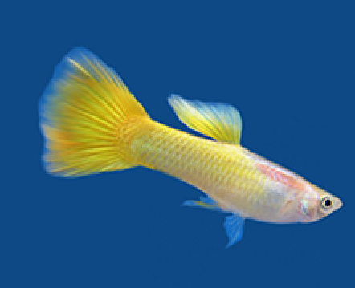
Fish Ahoy!
Betta fish
Fish
Guppy
Fish
Lemon guppy
Fish
1. Feed freshwater tank 1
Task
By: 15 Feb 2022
Freshwater tank 1

Slide 2

FISH AHOY!
Developer guide

Slide 3
FISH AHOY!
User guide

Slide 4
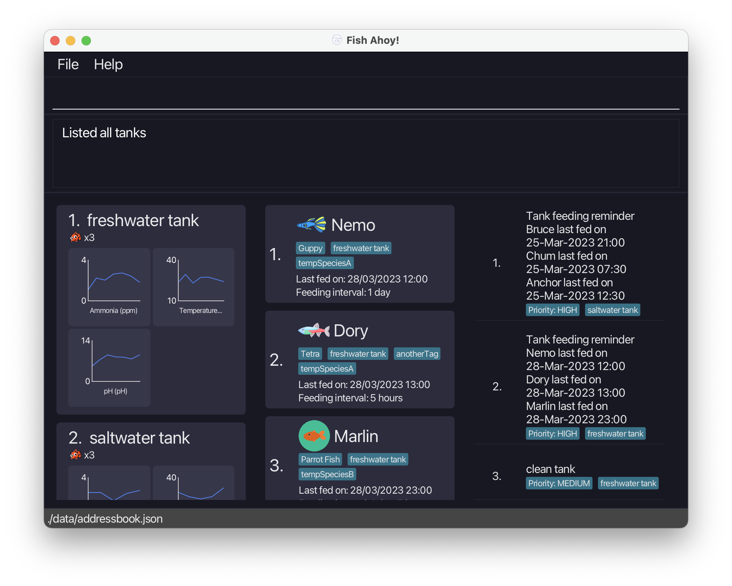

Slide 5
File
Exits the Application
Help
Displays User Guide
Command Line
Enter commands here
Alerts
Displays results from commands
Panels
Displays Tank, Fish and Task Information

Slide 6
Tank Index
Fish Index
Task Index

Slide 7
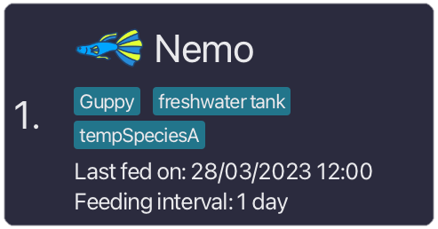
Fish Icon
Name
Species
Tank
Fish Index
Last Fed Date
Tags
Feeding Interval

Slide 8
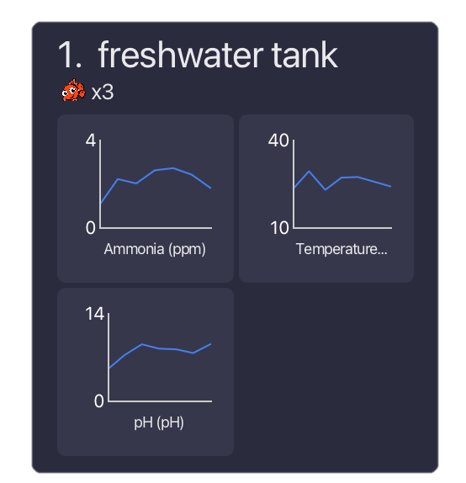
Tank Index
Description
Number of fish
Ammonia
Temperature
pH

Slide 9
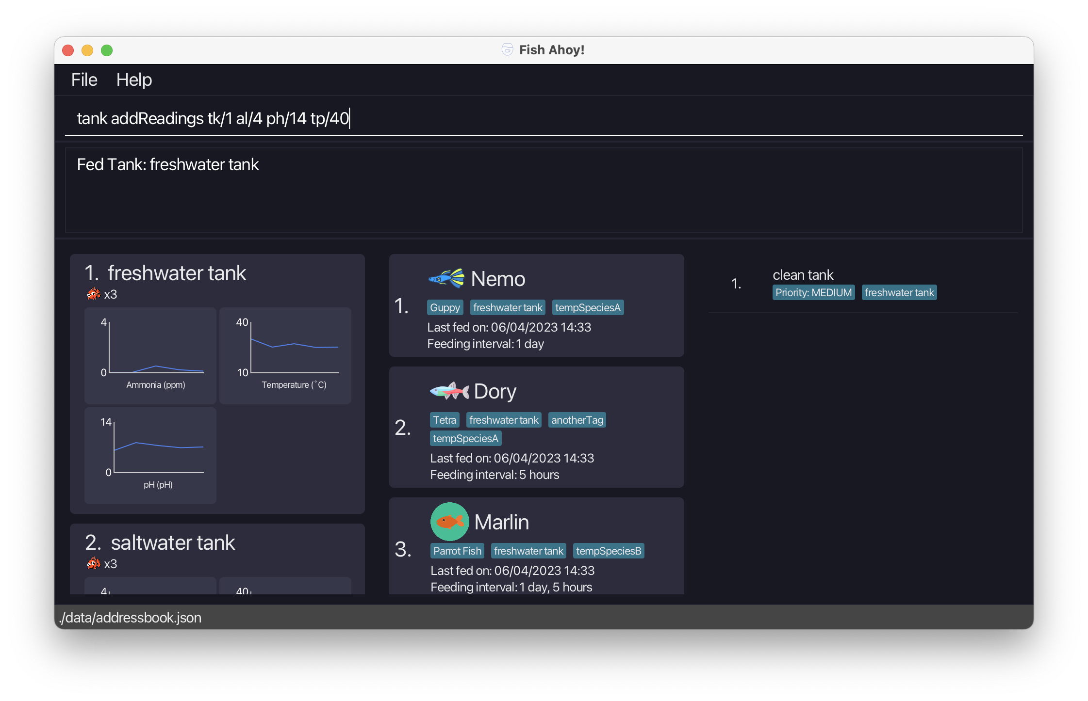
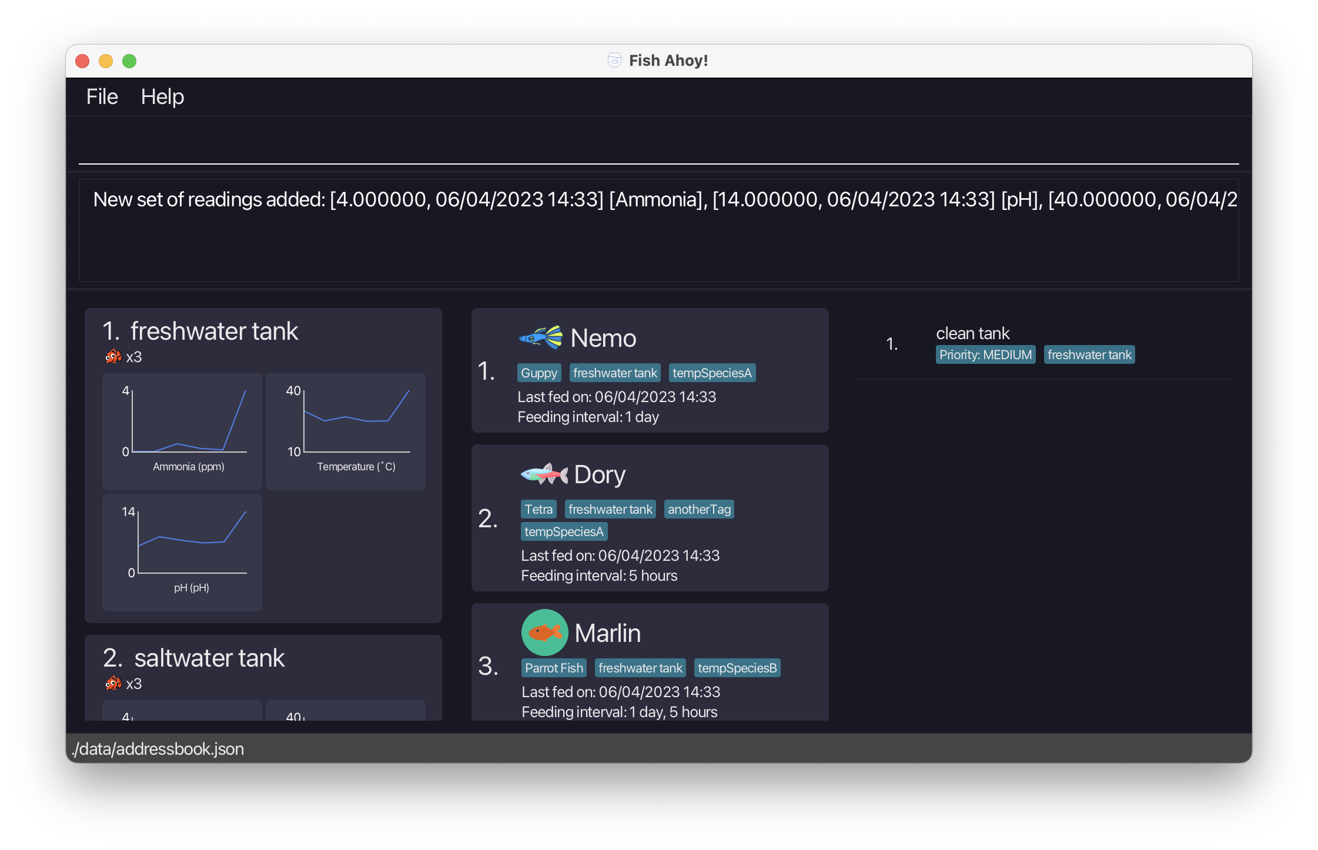
1
2

Slide 10
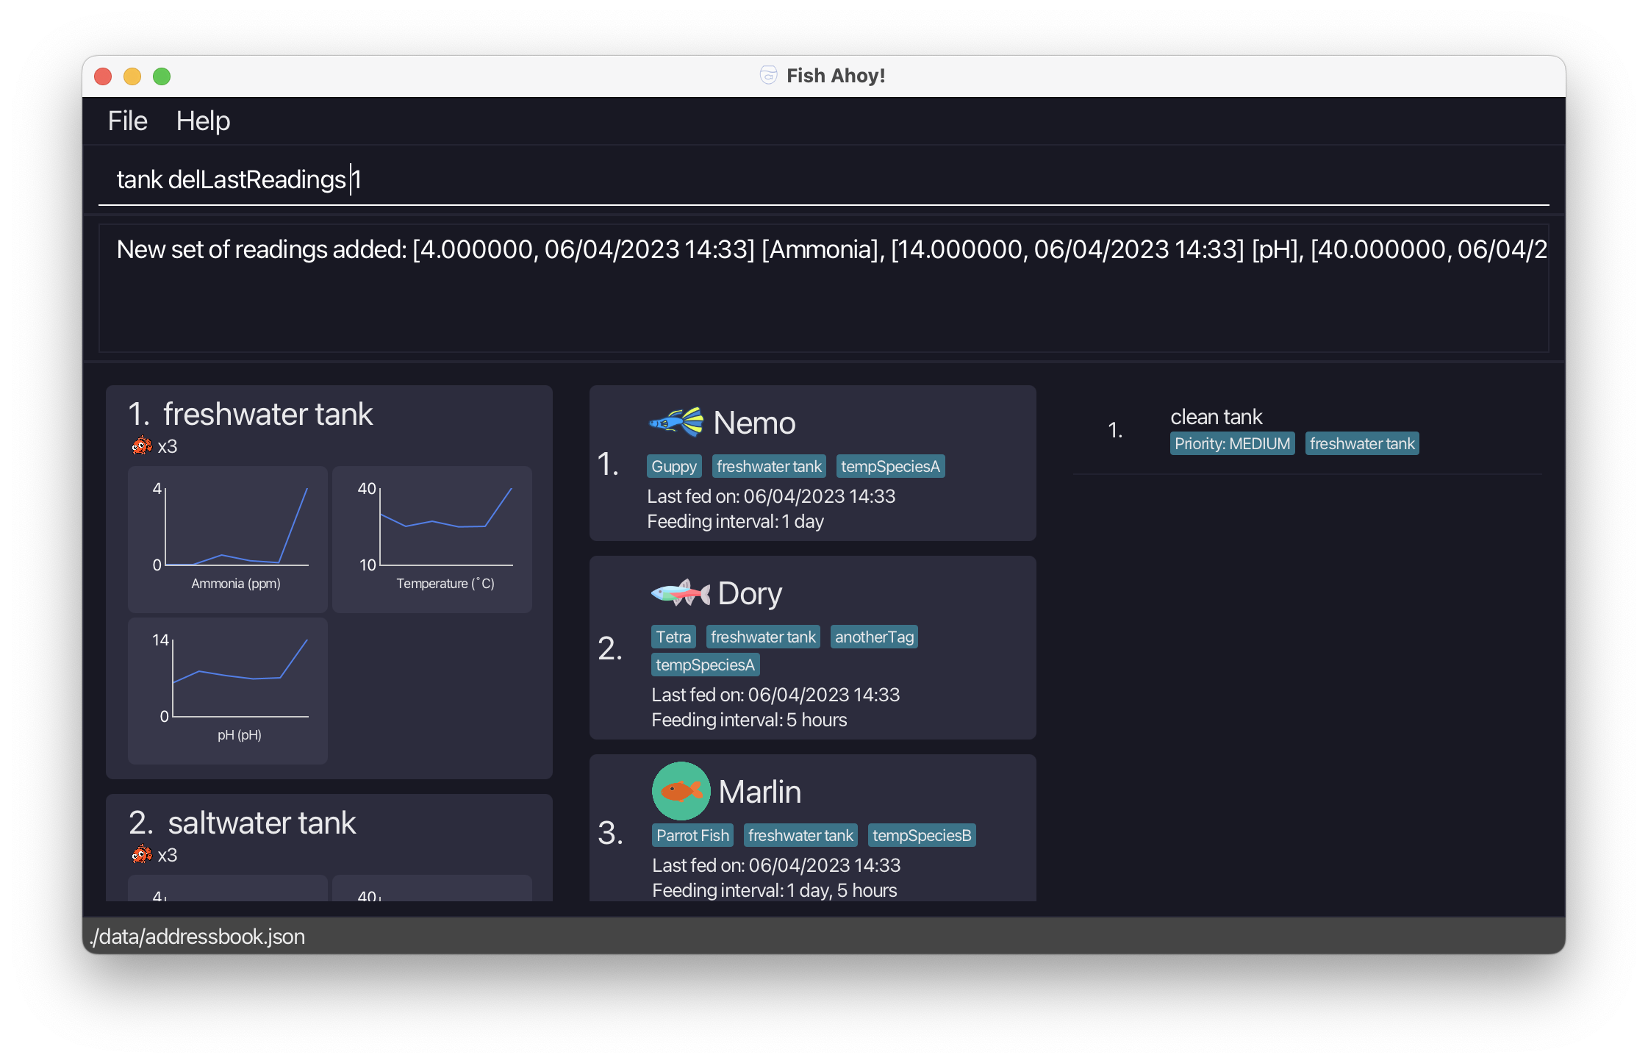

1
2

Slide 11
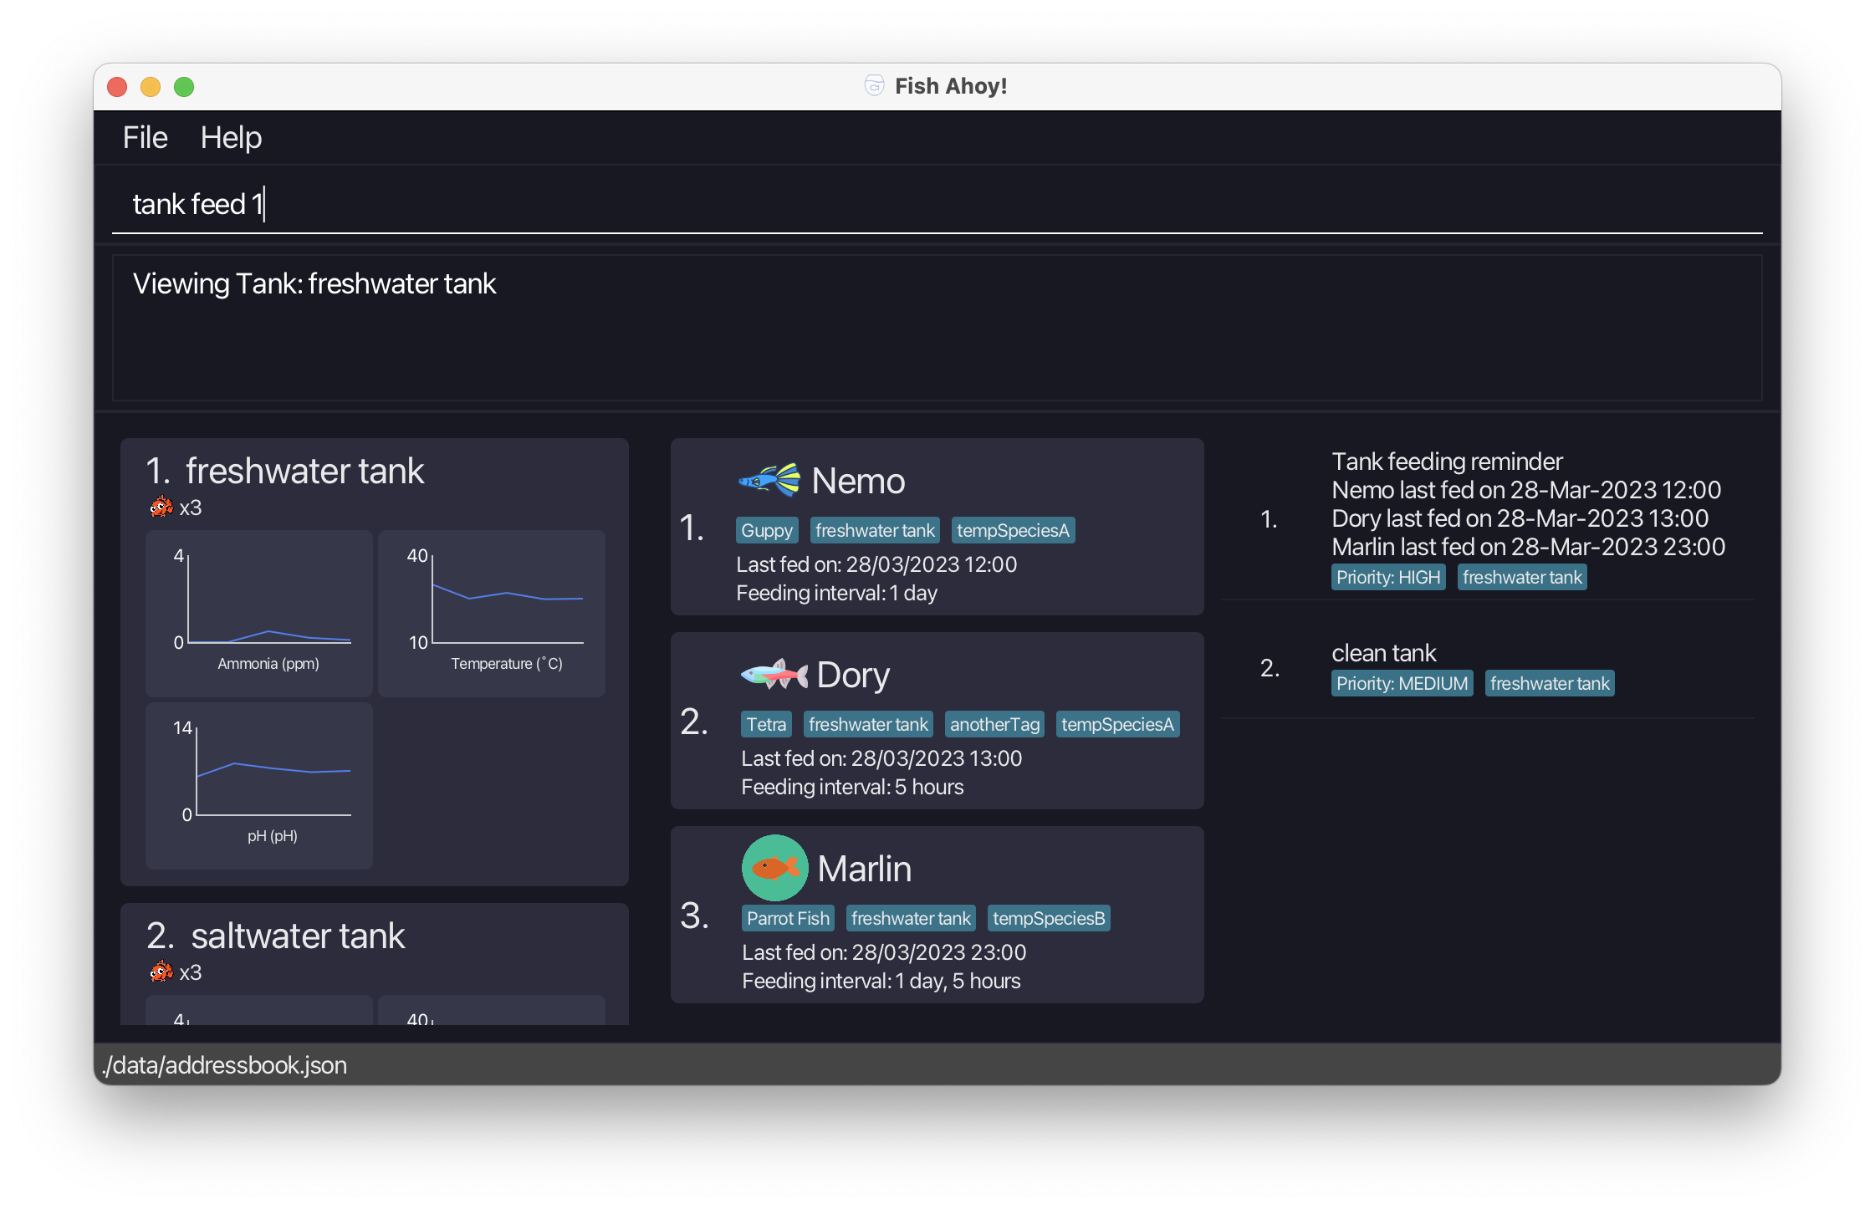
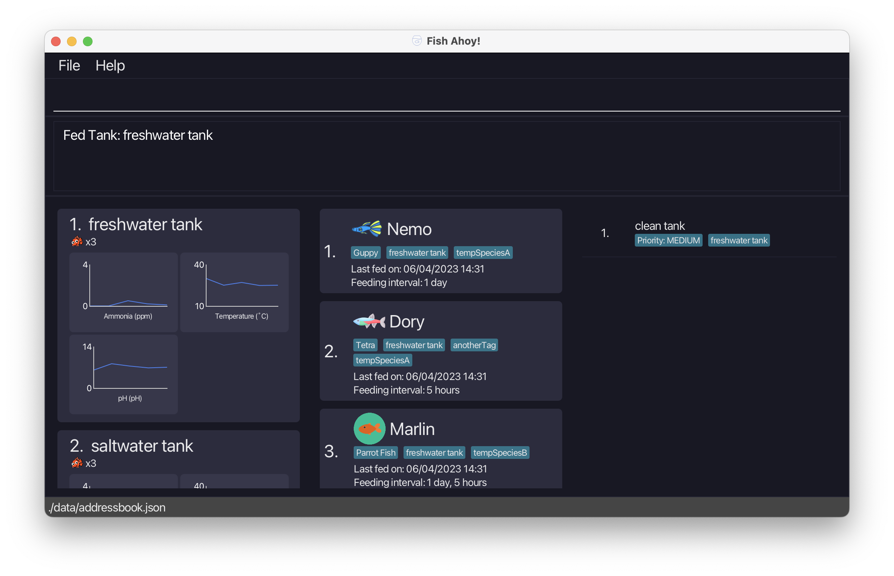
1
2

Slide 12
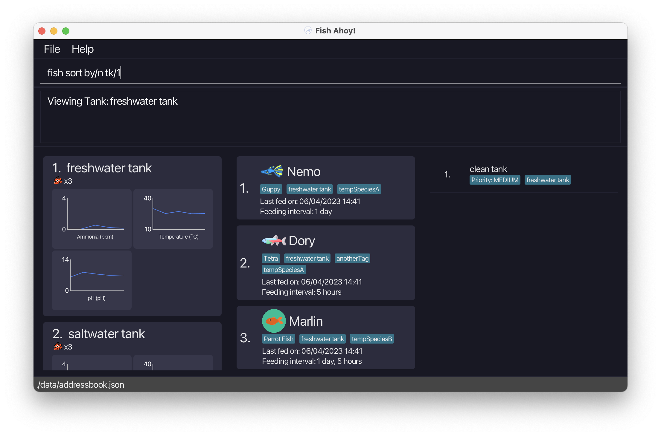

1
2

Slide 13
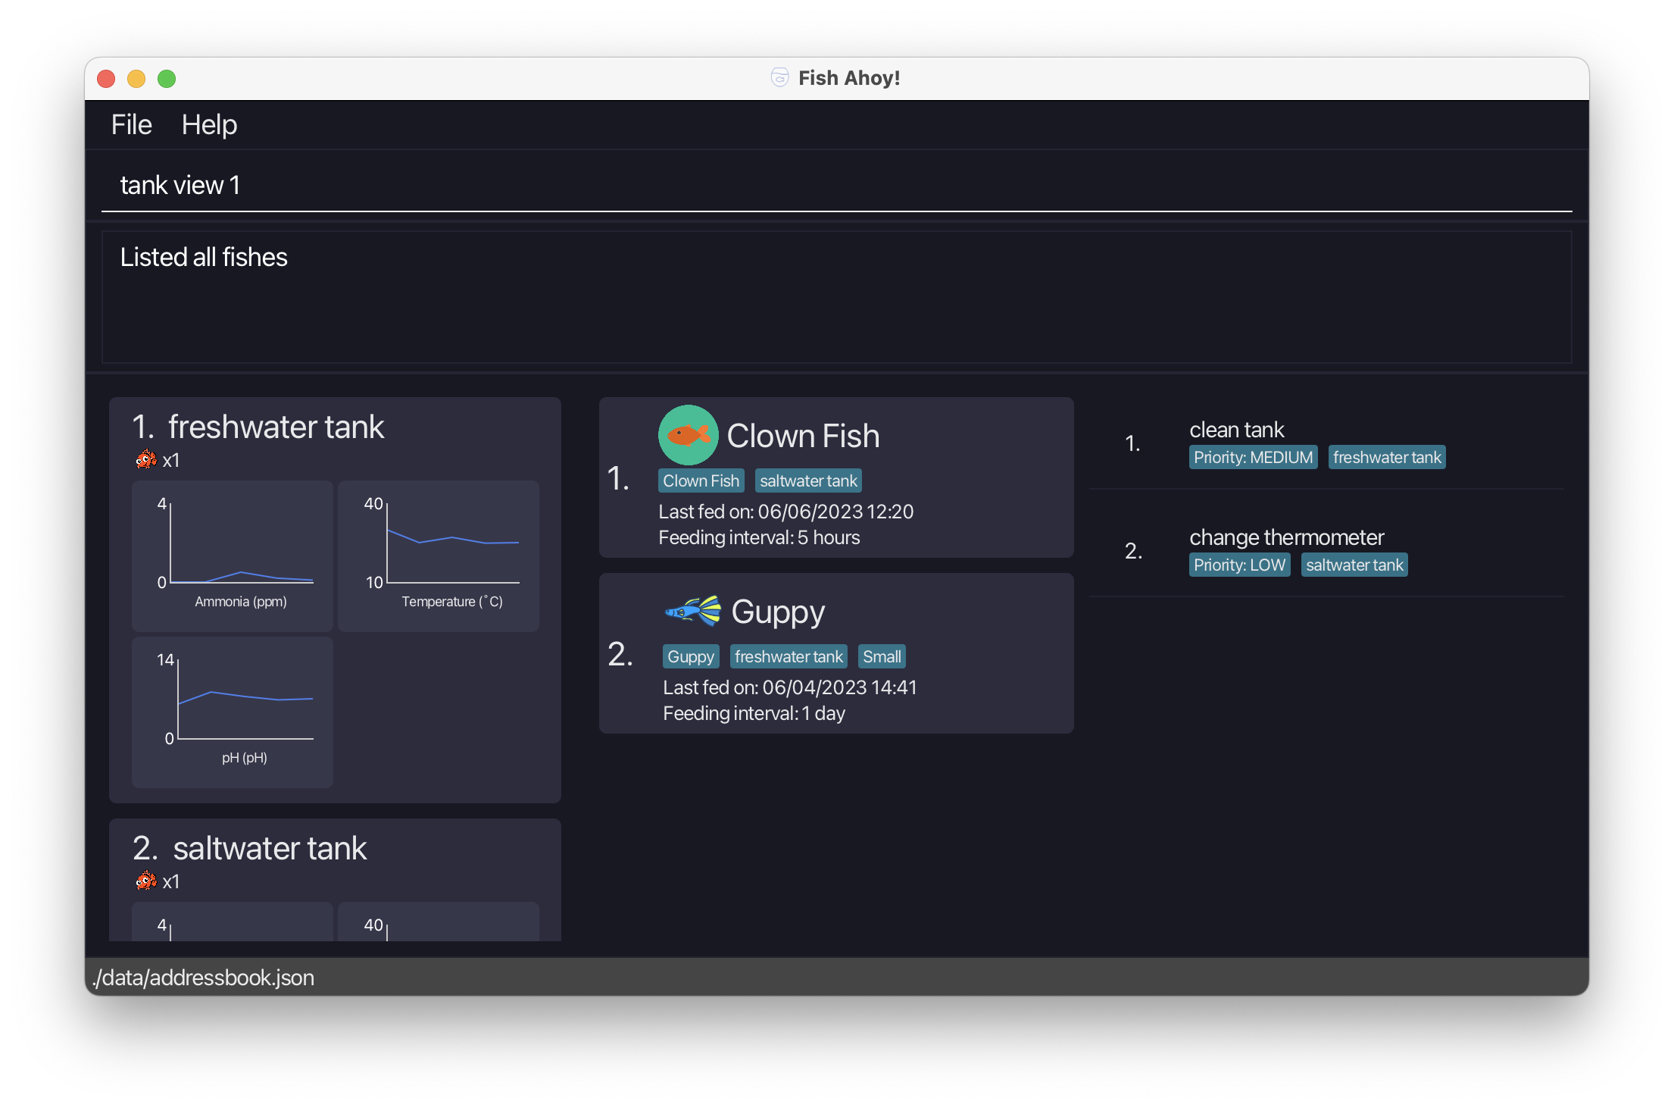
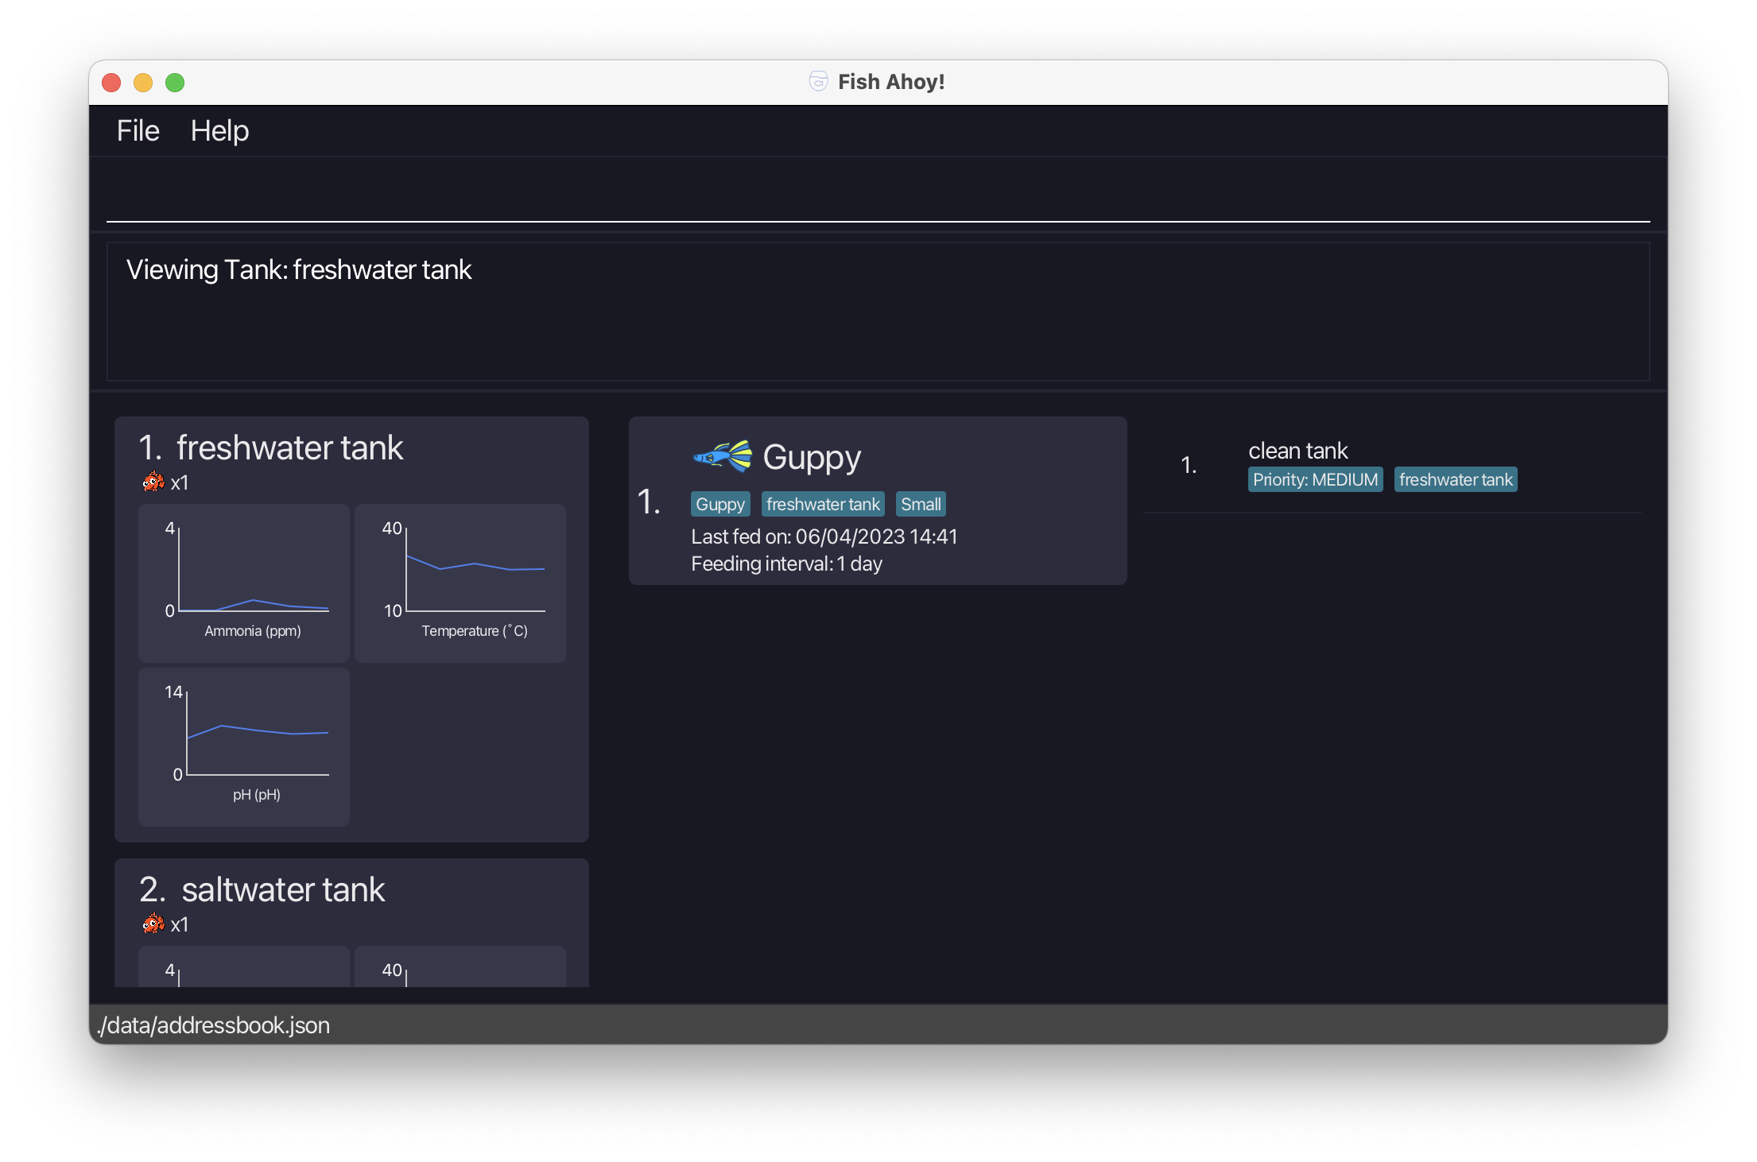
1
2

